Slide 1
Cleaning and Disinfection of Medical Instruments Ali Kermanjani MS, PhD Faculty of Medicine Iran University of Medical Sciences

Slide 2
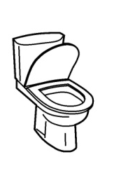
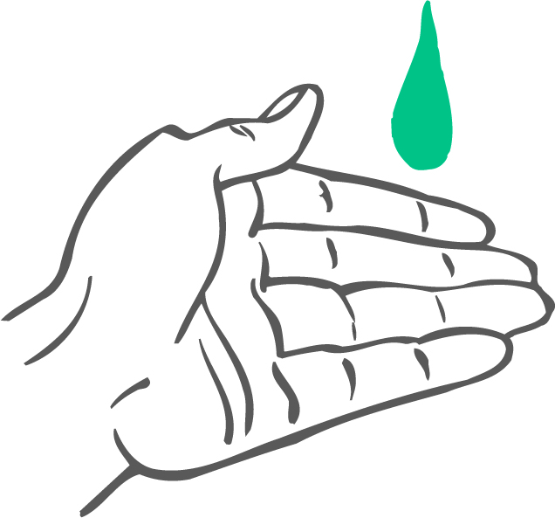
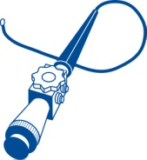
Vectors for transmission of infection
Asymptomatic patient
Healthy carrier
Environnement
Symptomatic
patient
Healthy
patient
Caregivers/Nurses

Slide 3
ایزولاسیون و احتیاطات
پاکسازی و ضدعفونی ابزار پزشکی
استفاده درست از آنتی بیوتیک ها
رعایت بهداشت دست
پاکسازی محیط

Slide 4
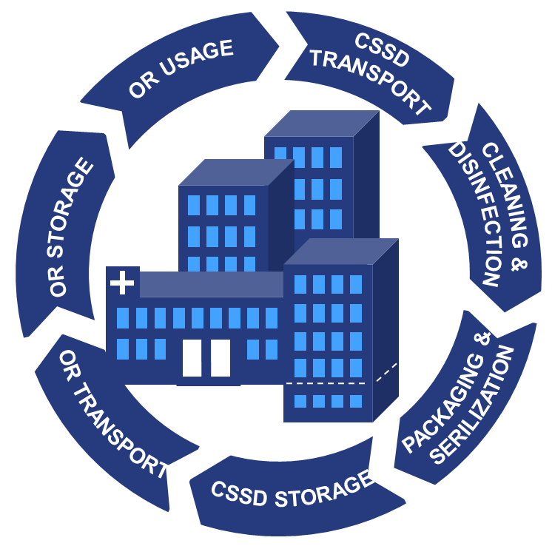
10 billion instruments are processed each year globally

Slide 5
Important Facts
Cleaning is the first step in device reprocessing after use.
You can clean without sterilizing, but you can never sterilize without cleaning.
Cleaning is the cornerstone of the sterilization process.

Slide 6
Terminology
Cleaning – The removal of all visible and non-visible soil and any other foreign material from the medical device being reprocessed.
Decontamination – Removing or reducing contamination by infectious organisms or other harmful substances.

Slide 7
Remove Gross Soil As Soon As Possible to:
Reduce the number of microorganisms on the item.
Reduce the nutrient material that can support microbial growth.
Reduce the potential for environmental contamination, aerosolization, or spillage.
Minimize damage to devices from blood and other substances.

Slide 8
USED INSTRUMENT > Potentially contaminated = DANGEROUS
Method Result
Cleaning and Disinfection Reduced number of pathogens, proteins are removed Safe for handling = safety for the staff
Inspection and care Instrument is proper functioning
Sterilization Safe for use = Safety for the patient

Slide 9
Pre-Cleaning/Cleaning
Everyone responsible for handling and reprocessing contaminated items must:
Receive adequate training and periodic retraining
Wear appropriate personal protective equipment (PPE)
Receive adequate prophylactic vaccinations
Notes:
Cleaning is the first step in the decontamination process. While ‘cleaning’ means to get rid of visible dirt, ‘pre-cleaning’ refers to the removal of body fluids and other contamination before disinfection or sterilisation. Proper pre-cleaning can substantially reduce the pathogen load while removing organic and inorganic residues to facilitate reprocessing. Thorough pre-cleaning is vital for successful disinfection and sterilisation.
Effective cleaning and pre-cleaning of devices often requires chemicals, combined with mechanical action and heat. It can be performed manually and/or with machines. Any equipment used must be regularly checked and maintained. There are a number of factors that determine the efficiency of the cleaning process, including the following:
Type and amount of soil
Quality of water
Type of detergent
Concentration of detergent
Type of instrument or device
Amount of time permitted for the detergent to act
Reusable items may be cleaned by hand, by use of mechanical equipment, or a combination of the two methods. Manual cleaning requires detergents or enzymes with friction (rubbing, brushing, flushing) to remove soil from the outside and inside of the items being reprocessed. The use of mechanical equipment can improve cleaning effectiveness, increase productivity, and promote employee safety. Various types of mechanical cleaning equipment are available such as washer disinfectors, ultrasonic cleaners and cart washers, and the equipment should be selected to meet the health care facility’s needs.

Slide 10
The Cleaning Process:
1st step: Softening. This is a prerequisite for cleaning effectively. This is based on general state-of-the-art principles by means of special liquids/detergents that may loosen dirt, biofilm a little and/or dissolve any bacteria that are present.
2nd step: Loosening. Loosening the softened dirt is part of the detachment process. At this stage, the softening process is not yet complete over the whole area. This means that parts of instrument are still coated with dirt.
3rd step: Detachment. Once the softening/loosening is complete, it becomes possible to detach any dirt coating the surface, for example by means of rinsing, possibly supported by brushing or other recognized procedures (e.g. water jets or ultrasound techniques).
4th step: Removal. As a final step removal of dirt is ensured by rinsing off residues. Recontamination of the instrument must be avoided. The instrument must be protected form recontamination of dirt which was previously removed from the same or other instruments.

Slide 11
Instrument Cleaning
Should begin within 15 minutes to 1 hour after use.
Prolonged delays in instrument cleaning can have negative impacts on instruments.

Slide 12
Blood should never be allowed to dry on instruments.
Process instruments immediately, or:
Cover with a moist towel
If they can be immersed, place in a soak basin with the appropriate solution.

Slide 13
Danger – Bacterial replication in a cleaning solution without disinfection properties
Bacteria double their number every X minutes. After certain hours bacteria can grow to a dangerous number.
A reliable disinfectant kills bacteria and prevents bacterial growth in the bath.

Slide 14
Bacterial replication is fast
20 min. 2 Bacteria
40 min. 4
1 hr. 8 E.Coli or
2 hrs. 64 Salmonella
3 hrs. 512 double their number
4 hrs. 4.096 every
5 hrs. 32.768 20 minutes
6 hrs. 262.144
6 hrs. 40 min. 1.048.576 Bacteria
Disinfection is needed immediately
before the bacteria grows
to a dangerous number!

Slide 15
Cleaning and Disinfection of Instruments
blood
germs
starting point
cleaning before disinfection reduces visible blood to zero
disinfection with aldehydes or alcohol before cleaning settles and bleaches protein
Surface of instrument
invisible
germs
Surface of instrument
blood
germs
Surface of instrument

Slide 16
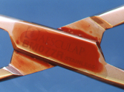
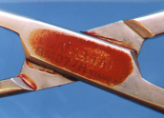
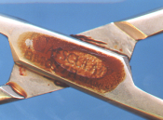
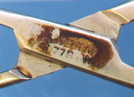
Aldehydes and Protein-fixing
contaminated with blood
after machine cleaning
after manual disinfection
after steam sterilization
Aldehydes

Slide 17
SHEA: Society for Healthcare Epidemiology of America (2010)

Slide 18
Patient Risks: Facts about Prions / CJD
UK: Instruments must be discarded and burned after use for surgery on known CJD-patients!
Instrument tracking becomes more and more relevant.
Prions can withstand heat e.g. autoclaving 121 °C – 21min. Therefore steam sterilisation at 134 °C is recommended.
Prions / Proteins are stabilized on metal surfaces of surgical instruments by protein fixing agents such as Aldehydes, Alcohols or heat.
after decontamination with aldehydes autoclaving even 134 °C / 18 minutes is not effective
Conclusion: Aldehydes are no longer recommended for reprocessing heat resistant (134°C) surgical instruments!

Slide 19
What are Biofilms?
Biofilms are collections of microorganisms (bacteria, yeasts, and protozoa) that form on a hard surface
Some examples of biofilms are the plaque that forms on teeth and the slime that forms on surfaces in watery areas

Slide 20
Steps in Biofilm formation
Formation of conditioning layer
Planktonic bacterial cell attatchment
Detachment ( seeding dispersal )
Bacterial growth and Biofilm Expansion

Slide 21
Antimicrobial-resistant responsible for 65% of infections
Up to 1,000 times more resistant to antimicrobials

Slide 22
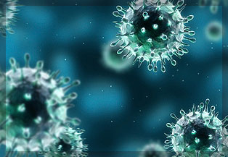
Disinfection

Slide 23
Spaulding Classification
Divided hospital instruments into general categories based on the risk of infection involved in their use
Critical items
Semi critical item
Non critical items
Notes:
In 1968, Dr. EH Spaulding classified medical/surgical devices as: critical, semi-critical and non-critical based on their potential to spread infections.
While the Spaulding classification system remains useful, it needs adjusting to suit current requirements. Prions with their unusual resistance to many physical and chemical agents and the emergence of the spore-former Clostridium difficile as a healthcare-associated pathogen, are forcing a re-examination of medical device reprocessing. Prion-contaminated devices require sterilisation protocols well beyond those in normal use. Some disinfectants (e.g., glutaraldehyde) normally used to reprocess gastrointestinal endoscopes need prolonged contact times to kill C. difficile spores. Heat-sensitive devices such as flexible fibreoptic endoscopes are increasingly being used for operations in which the integrity of a mucous membrane is deliberately breached, thus blurring the line between ‘critical’ and ‘semi-critical’.

Slide 24
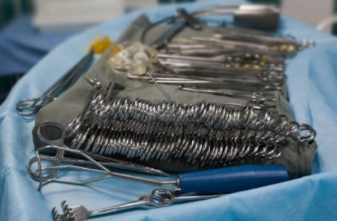
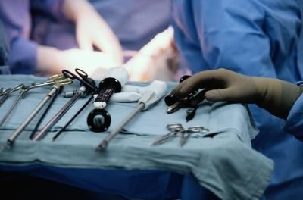
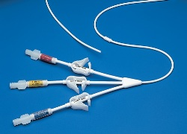
Critical Items
Enter normally sterile tissues, the vascular system, or equipment through which blood flows
Items must be properly and safely cleaned, disinfected and sterilised before use
Notes:
Critical items enter normally sterile tissues, the vascular system, or equipment through which blood flows; for example: surgical instruments and vascular catheters. These items must be properly and safely pre-cleaned and sterilised before use.

Slide 25
Critical Items - Examples
Implants
Surgical instruments
Needles
Cardiac catheters
Urinary catheters
Biopsy forceps of endoscope

Slide 26
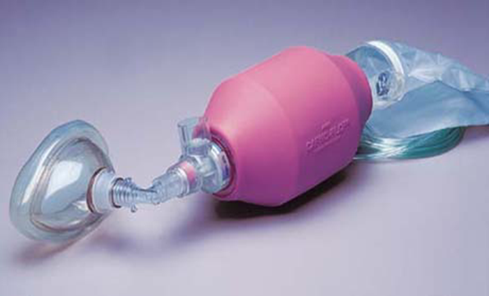
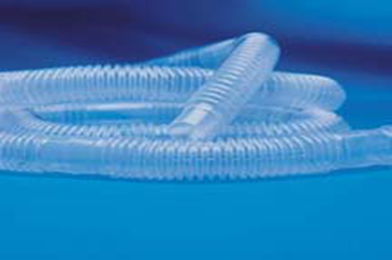
Semi-critical Items
Contact mucous membranes but do not penetrate soft tissue or body surfaces
Meticulous physical cleaning followed by appropriate high-level disinfection
Notes:
Semi-critical items come into contact with intact mucous membranes or non-intact skin; flexible fibreoptic endoscopes, vaginal probes, and respiratory therapy equipment are examples. These items require proper pre-cleaning and, at a minimum, high-level disinfection before use.

Slide 27
Semi-critical Item - Examples
Flexible fiberoptic endoscopes
Respiratory therapy equipment
Anaesthesia equipment
Endotracheal tubes
Bronchoscopes
Vaginal specula

Slide 28
Non Critical Items
Direct contact with the patients intact skin (unbroken skin)
Little risk of pathogen transmission directly to patient
Clean and disinfect using a low to intermediate level disinfectant
Notes:
Noncritical instruments and devices only contact intact (unbroken) skin, which serves as an effective barrier to microorganisms. These items carry such a low risk of transmitting infections that they usually require only cleaning and low-level disinfection. However, if an item is visibly bloody, it should be cleaned and disinfected using an intermediate-level disinfectant before use on another patient.
Examples of instruments in this category include X-ray head/cones, facebows, pulse oximeter, and blood pressure cuff.

Slide 29
Examples of Non Critical Items
Items which are in contact with intact skin
Blood pressure cuffs
Crutches
Stethoscopes
Face mask
X-ray machine
Notes:
Most environmental surfaces in patient rooms and throughout a health care facility are non-critical and do not require routine disinfection. However, high-touch surfaces, particularly those in a patient’s immediate surroundings that might come in contact with the patient, need regular cleaning to prevent the transfer of pathogens to hands. Currently, there are no generally accepted guidelines regarding: if, when, how, and how often such surfaces are to be cleaned.

Slide 30
Disinfection
Reduction in numbers of pathogens on inanimate surfaces/objects
For items that will contact intact skin or mucous membrane
Use physical or chemical agents or both
Level of disinfection
High-level
Intermediate-level
Low-level
Notes:
Common chemical disinfectants include alcohols, chlorine and chlorine compounds, glutaraldehyde, ortho-phthalaldehyde, hydrogen peroxide, peracetic acid, phenolics, biguanides, and quaternary ammonium compounds (QAC). Such chemicals can be used alone or in combination. They must be used in accordance with the manufacturer’s instructions and only on surfaces with which they are compatible.
Ideally, commercial products should pass standard tests to support label claims before being sold for use in health care settings. However, requirements for product registration and allowable label claims vary widely from region to region. This not only interferes with global harmonisation, it also makes testing products prohibitively expensive.
There are often serious disparities between what is claimed on the product label and its actual use. For example, the recommended contact time for environmental surface disinfectants is usually much too long for practical use. Chemical disinfectants vary widely in the harm they can cause to humans and the environment, so must be used carefully, and only when no suitable alternatives are available.
Disinfectants are placed into three categories depending on microbicidal activity – high-level, intermediate-level & low-level. Not all regions use this terminology.
Proper disinfection depends on using an appropriate disinfectant at the right concentration and for adequate contact time. It is also important to follow the manufacturer’s instructions for disinfectant handling, preparation, use and storage. Incorrect dilution, poor storage and repeated use of the same working solution reduce the effectiveness of chemical disinfection. Choose disinfectants with the following characteristics:
• Wide range of activity
• Not readily inactivated
• Non-corrosive when diluted
• Non-irritant to skin
• Low cost

Slide 31
High-level Disinfectants - 1
Active against vegetative bacteria, viruses (including the non-enveloped ones), fungi, and mycobacteria
May have some activity against bacterial spores
HLDs are used to disinfect heat-sensitive and semi-critical devices
Such as flexible fibreoptic endoscopes
Notes:
High-level disinfectants (HLD) are active against vegetative bacteria, viruses (including the non-enveloped ones), fungi, and mycobacteria. It may also have some activity against bacterial spores with extended contact times. HLDs are used to disinfect heat-sensitive and semi-critical devices such as flexible fibreoptic endoscopes.
Aldehydes (glutaraldehyde and ortho-phthalaldehyde) and oxidisers (e.g., hydrogen peroxide and peracetic acid) are HLDs. The aldehydes are non-corrosive and safe for use on most devices. However, they can fix organic materials, therefore it is particularly important to remove any embedded microbes prior to disinfection.
Unless properly formulated and carefully used, oxidisers can be corrosive. However, they can be faster-acting, non-fixative and safer for the environment than aldehydes.

Slide 32
High-level disinfectants - 2
HLDs typically require 10-45 minutes contact time
Depends on the temperature
After disinfection, items require thorough rinsing/flushing with sterile or filtered water to remove any chemical residues
Notes:
HLDs typically require 10-45 minutes contact time for disinfection, depending on the temperature. After disinfection, items require thorough rinsing with sterile or filtered water to remove any chemical residues; they must then be dried with an alcohol rinse or by blowing clean and filtered air through the device’s channels prior to safe storage. Dry well and store properly to prevent damage or recontamination.

Slide 33
Intermediate-level Disinfectants
Active against vegetative bacteria, mycobacteria, fungi and most viruses
May fail to kill spores
Notes:
A disinfectant active against vegetative bacteria, mycobacteria, fungi and most viruses. It may fail to kill spores, even after prolonged exposure.

Slide 34
Low-level Disinfectants
Active against vegetative bacteria (except
mycobacteria), some fungi, and only enveloped viruses
In many cases, washing with unmedicated soap and water would be sufficient in place of LLD
Notes:
Low-level disinfectants (LLD) are active against vegetative bacteria (except mycobacteria), some fungi, and only enveloped viruses. In many cases, washing with unmedicated soap and water would be sufficient in place of LLD.

Slide 35
Factors Affecting Sterilization or Disinfection
AMOUNT OF ORGANIC MATERIAL
Number of microorganisms
Type of microorganisms (resistance levels)
Type of germicidal agent
Concentration of germicidal agent
Exposure time to germicidal agent
Temperature of exposure

Slide 36
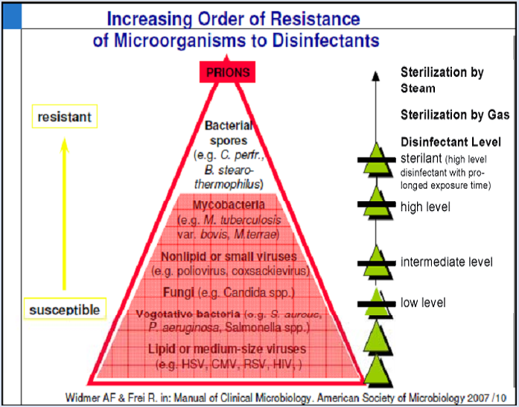

Slide 37
A.Kermanjani@gmail.com
Thanks a lot

